Slide 1
Detecting driver phone use leveraging car speakers
amar bessedik – PAPER #10
Authors:
Jie Yang, Simon Sidhom, Gayathri Chandrasekaran , Tam Vu , Hongbo Liu, Nicolae Cecan, Yingying Chen, Marco Gruteser∗, Richard P. Martin

Slide 2
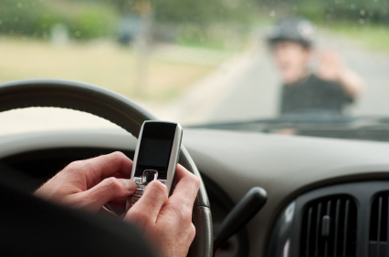
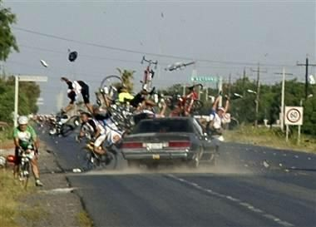
On decreasing cell phone distractions WHILE DRIVING
SOME OF THE TECHNOLOGIES THAT WERE USED:
Radio jammers, call & text blocking
Automatic replay to callers
Delay incoming calls
Routing call to voicemail box
THE QUESTION:
HOW CAN WE KNOW WHETHER A PHONE IS USED BY A DRIVER
OF BY A PASSSENGER IN A MOVINF VEHICLE?

Slide 3

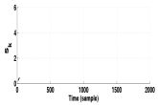

The idea behind: ACCOUSTIC RANGINE APPROACH
Intended to specify on which car seat a phone is located
The system relies on 2 assumptions:
Seat location a useful discriminator for distinguishing driver & passenger cell phone use
Most cars will allow phone access to the car audio infrastructure
Challenges and design goals:
1- Unobtrusiveness: The sounds emitted by the system should not be perceptible by the human ear.
2- Robustness to noise and multipath: engine noise, tire & road noise, wind noise, conversations, etc.
3- Computational feasibility on smartphones: Standard smartphone platforms should be able to execute the signal processing
Emit beep signal
Record signal
Filtering
Signal Detection

Slide 4
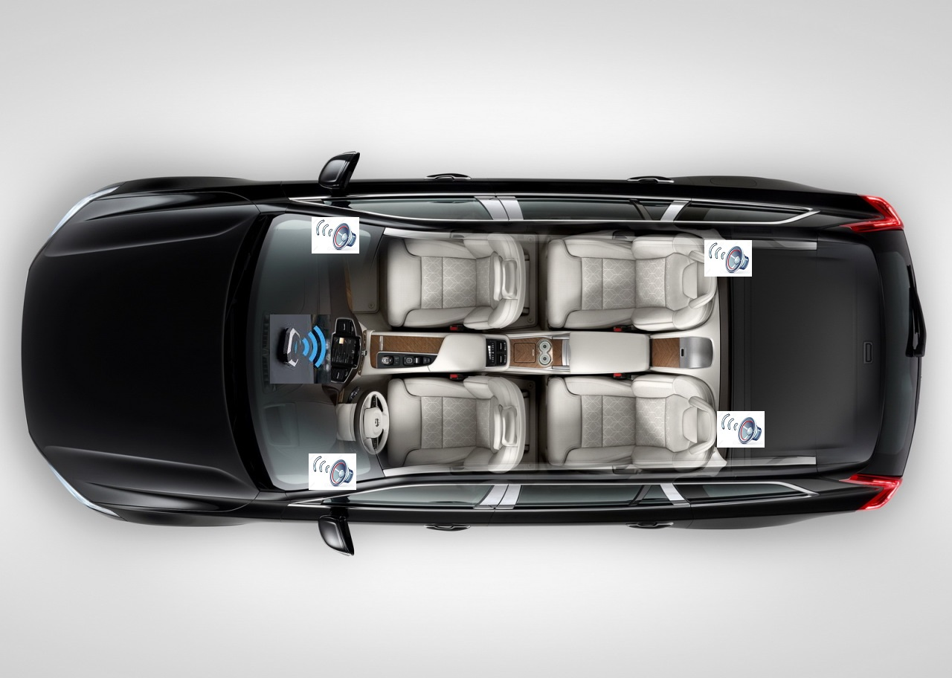

How does the system work?
The system, when triggered, say by an
incoming call, transmits an audio signal via
Bluetooth to the car’s head unit.
The signal then played through the car speakers
The phone records the emitted sound
through its microphone and process the
recorded signal to evaluate propagation delay

Slide 5
How the relative ranging time is calculated
S1: Driver seat
S2: front passenger seat
S3, S4 back seats
∆t: PREDEFINED FIXED TIME INTERVAL BETWEEN TWO BEEP SOUNDS
∆t_{1/2:} CALCULATED TIME DIFFERENCE OF ARRIVAL BASED ON SIGNAL DETECTION
RELATIVE RANGING: LOCATION OFCELL PHONE TO TWO SPEAKERS
IF ∆t₁ - ∆t > 0 , Closer to Left Speaker (S₁ )
IF ∆t₁ - ∆t < 0 , Closer to Right Speaker (S₂ )
IF ∆t₂ - ∆t > 0 , Closer to Front Speaker (S_{1,} S₂)
IF ∆t₂ - ∆t < 0 , Closer to Back Speaker (S_{3, 4})
∆t_{1/2} - ∆t
Driver
vs.
non-Driver
Relative Ranging
Location Classification

Slide 6
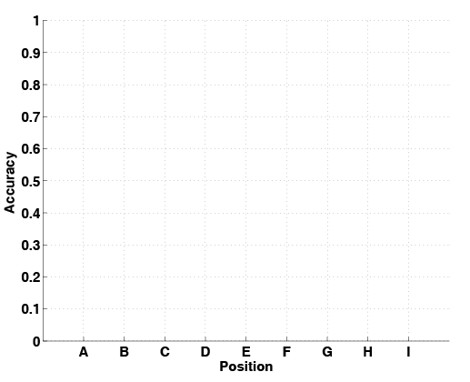
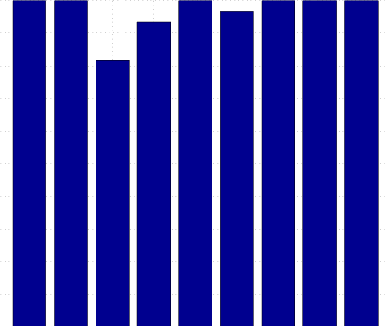
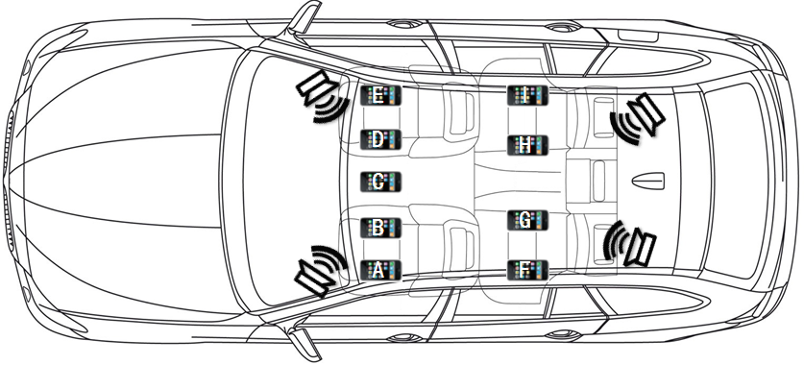
Results & system accuracy
Position C: Cup-holder
Position D: Co-driver left

Slide 7
conclusions
The system requires only software changes on smartphone
Achieves this by using the existing infrastructure of car speakers via Bluetooth
Detects driver’s phone by estimating the range between the phone and car speakers
The designed signal is unobtrusive as well as robust to background noise
Achieves over 90% of detection rates as well as accuracy with low false positive rate.

